Slide 1
SBK 3013
PRINCIPLES IN BIOCHEMISTRY
GROUP MEMBERS:
JANATHU FERDAUS BINTI PAJARU RAHMAN
MAHIRAH BINTI ZAINAL ABIDIN
NUR LIYANA BINTI A. RAZAK
NUR ATHIRAH BINTI ZALBADOR
NADIRAH BINTI ZAINAL ABIDIN
MERINY JOREEN ANAK MATIAS
NUR SYALIYANA BINTI ABU SAMAH
AINUL ‘IZZATTI BINTI ZULKIFLI
NURUL AKMA BT YAZIZ

Slide 2
What Is Haze?
The haze is caused by the tiny particulates suspended in the atmosphere.
At high concentration, these particulates scatter and absorb sunlight resulting in diminished visibility.
Haze is produced when sunlight comes in contact with certain gases in the atmosphere.
The types of aerosols formed through this photochemical reaction depend on the specific composition of the atmosphere.
Haze is not confined in urban areas, but also in rural areas.

Slide 3
Origin Of Haze
The particles that cause the haze phenomenon can originate from many sources, some of which are natural and some anthropogenic.
Natural sources include the oceans, forests and ground surface.
However the majority of the particulates are from human activities which include open burning, land clearing, vehicular use and combustion of fossil fuels in industrial boilers
The main cause of this haze is the slash and burn practice by farmers and peat fires blown by the wind from Indonesia. especially Sumatra, which mainly affects the Peninsular Malaysia and Kalimantan, which mainly affects East Malaysia.
Some are spending time in Kalimantan or Sumatra during the dry season knows that burning land for agriculture, for hunting, or just for fun is a favorite pastime of many. This causes much of the origin of haze in Malaysia.

Slide 4
WHAT ARE THE PARTICLES IN THE HAZE?
A mixture of solid particles and liquid droplets suspended in air (eg:artificial aerosol).
Haze droplets is the sulfuric acid.
The particles found in haze are microscopic particles (2.5mm> in diameter) and larger particles (10mm< in diameter).
The microscopic particles can get deep into the lungs-tend to pose the greatest health concerns.
The larger particles can irritate the eyes, nose and throats.

Slide 5
WHAT ARE THE PARTICLES IN HAZE?
Much of the sulfuric acid may be traced to the release of sulfur dioxide
Once in the atmosphere, sulfur dioxide tends to bond with oxygen.
Sometimes, the oxidation reactions enhanced by sunlight and sometimes the reactions occurs in the presence of liquid water.
Result of this chemical reaction is the formation of sulfates (the compounds of sulfur and oxygen).

Slide 6
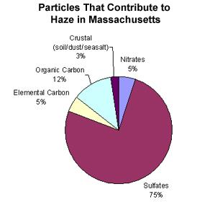

Slide 7
Respiration In Human During Haze
When the air quality reaches 'Unhealthy' levels, it is more likely to trigger mild aggravation of respiratory illness symptoms among those suffering from chronic lung or heart ailments.
The NEA has summarised the air quality categories as based on PSI and how they affect our general health issues such as triggering coughs, eye irritation and sneezing.
The lung defence mechanisms against inhaled particles and gaseous pollutants include innate mechanisms such as aerodynamic filtration, mucociliary clearance, particle transport and detoxification by alveolar macrophages, as well as local and systemic innate and acquired antiviral immunity
In particular, alveolar macrophages provide an defence mechanism against bacteria and viruses
Collective findings from both animal and human provide some evidence of alterations in local bronchial immunity; acute exposure to oxidant pollutants results in ciliostasis in both the upper and lower airways which may prevent the nasal and bronchial mucosa filtering inhaled particles.

Slide 8
What is cloud seeding?
Cloud seeding is the process of spreading either dry ice or more commonly, silver iodide aerosol into the upper part of clouds to try to stimulate the precipitation process and form rain.
The process of cloud seeding begins with the chemical known as silver iodine that contains a crystal structure, which is the same with water ice.
once the silver iodine has been dispersed into the clouds, this may cause the droplets of water within the clouds from undergoing nucleation that causes super cooling, formation of ice crystal and spontaneous clouds development.

Slide 9
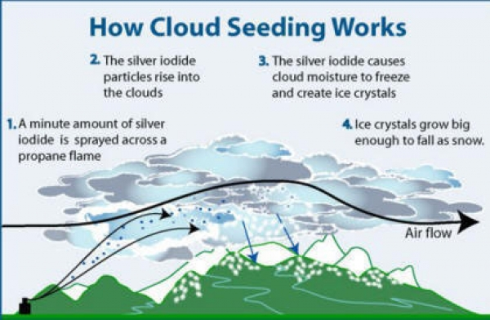

Slide 10
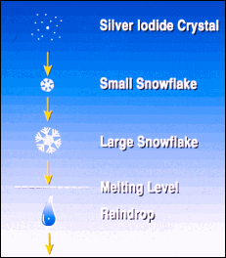
Type of Cloud Seeding
Static cloud seeding - spreading a chemical like silver iodide into clouds.
silver iodide provides a crystal around which moisture can condense.
The moisture is already present in the clouds, but silver iodide essentially makes rain clouds more effective at dispensing their water.hahahahha ayon
ha

Slide 11
Hygroscopic cloud seeding disperses salts through flares or explosives in the lower portions of clouds. The salts grow in size as water joins with them. In his report on cloud seeding, Cotton says that hygroscopic cloud seeding holds much promise, but requires further research.
TEKAN DISINI :)

Slide 12
Dynamic cloud seeding aims to boost vertical air currents - encourages more water to pass through the clouds, translating into more rain. Up to 100 times more ice crystals are used in dynamic cloud seeding than in the static method. The process is considered more complex than static clouding seeding because it depends on a sequence of events working properly. Dr. William R. Cotton and other researchers break down dynamic cloud seeding into 11 separate stages. An unexpected outcome in one stage could ruin the entire process, making the technique less dependable than static cloud seeding.

Slide 13
Important of cloud seeding
Creation of rain.
-create rain in areas that most affected by drought.
-bring rain to the areas that need it.
Making all areas more hospitable
-increase rainfall and make typical dry areas of the world more hospitable.

Slide 14
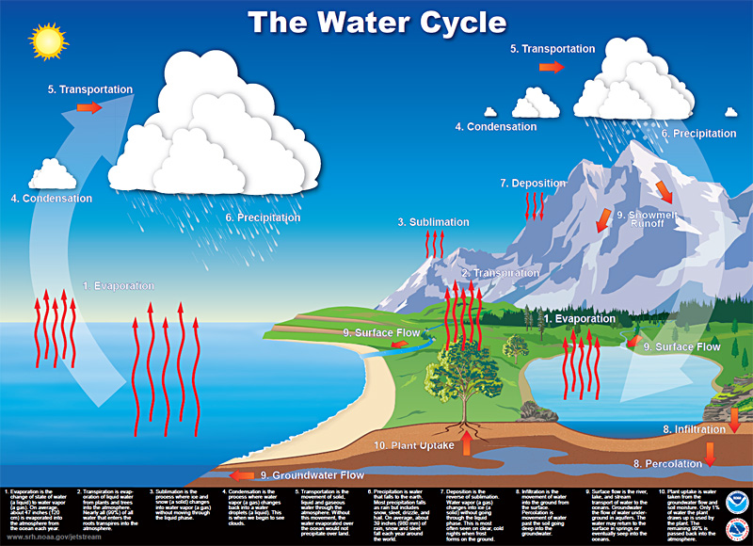

Slide 15
Impact of cloud seeding
chemical composition of rainwater
normal rainwater
dilute with average total dissolve salt contain of a few miligram per litre and weakly acidic ( pH 4-6)
acidic rainwater
composition of acid rain caused by emission of sulphur dioxide and nitrogen oxide,which react with water molecules in the atmosphere to produce acids
carbonic acid then can ionize in water forming low concentration of hydronium and carbonate ions
H₂O (l) + CO₂ (g) H₂CO₃ (aq)

Slide 16
harmful of acid rain to environment and health
very dangerous for trees and forest-
-rids the soil very important nutrients like magnesium and calcium.
-without these nutrients, trees are more vulnerable to infections and damage by cold weather and insects.
allow aluminium to seep the into the soil
-with too much aluminium in soil make trees hard to collecting water
destroy leaf outer-coat and when it finnaly wears down its prevent the tree to make photosinthesis.

Slide 17
harmful to human
-breath in the acid molecule
-getting lung and respiratory problem

Slide 18
how to reduce the acid in rainwater
neutralisation
acid react with calcium carbonate to reduce neutral compound and carbon dioxide.
CaCO₃ + H₂SO₄ –> CaSO₄ + H₂CO₃
H₂CO₃ –> CO₂ gas + H₂O

